Slide 1
Construction
Presented by:
Ashish Maharjan (Roll No. 11)
Tulsi Acharya (Roll No. 12)

Slide 2
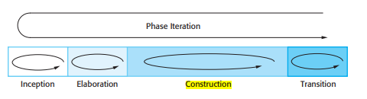
Construction
Largest phase
The development of the system is completed here.
Consists of design and implementation.
All features are considered to be developed and are carefully tested.
Achieve useful version like alpha, beta and other releases as soon as possible.

Slide 3
Construction
Introduction
The Design Model
Block design
Working with construction

Slide 4
Introduction
Why do we have a construction process?
What is done in the construction phase?

Slide 5
Why do we have construction process?
The analysis model is not sufficiently formal
The actual system must be adapted to the implementation environment
We want to validate the analysis result

Slide 6
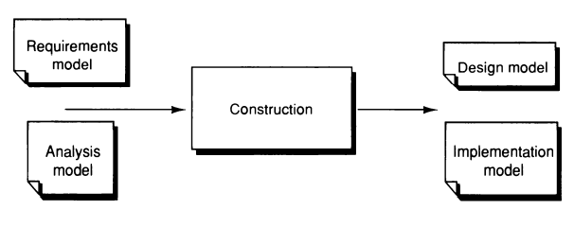
What is done in the construction phase?
Identify and investigate the consequences that the implementation environment will have on the design.
Use the analysis model as a base and translate the analysis object into design object in the design model that fits the current implementation environment.
Specify each specific flow in the system in detail using use-case.

Slide 7
What is Design Model?
The structure of the object is adjusted to support the implementation environment.
Any change in the design model must be updated in analysis model.
Interaction diagram is created in design model.

Slide 8
The Design model
Traceability
The implementation environment
Interaction diagram
Definition of stimuli
Structure of interaction diagrams
Use cases with extensions
Homogenization

Slide 9
Traceability
Most important property is system development.
It is the ability to trace work items across the development lifecycle.
Easily find your way in the system even if it has been subjected to major changes.
It's used to keep track of what's going on in the development lifecycle and show what's happened.

Slide 10
The implementation environment
Understanding the relationships between the software that is being designed and its external environment is essential for deciding how to provide the required system functionality and how to structure the system to communicate with its environment.
Establish the boundaries of the system which helps you decide what features are implemented in the system being designed and what features are in other associated systems.

Slide 11
Interaction diagram
Interaction diagram is created for each use-case diagram.
Interaction diagram contains the detail description of different signals sent and received by the system.
The main purpose of interaction diagram is to define the protocols of each blocks in the system.

Slide 12

Definition of Stimuli
Stimuli are the events that gives rise to a new event in interaction diagram.
Sent from one one object to another and initiate as operation.
Types of Stimuli

Slide 13
Structure of Interaction Diagrams
Interaction diagram give the designer a unique ability to see the entire sequence in a use case as an overview level.
Pictorial overview of how the sequence progress over the objects participating in use case.
Types of Interaction Diagram
Fork Diagram
Stair Diagram

Slide 14
Fork Diagram VS Stair Diagram
Fork Diagram is characterized by the fact that is an object acting like a spider in web and so controls the other ojbects.It has centralized structure. A centralized (fork) control structure is appropriate when:
the operations can change order.
new operations could be inserted.
Stair diagram is characterized by delegate responsibility. It has decentralized structure. A decentralized (stair) control structure is appropriate when:
the operations have a strong connection.
the operations will always be performed in the same order.

Slide 15
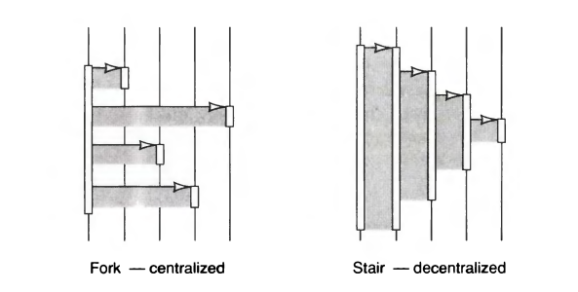

Slide 16
Use cases with extensions
Use of one use case to extend another use case.
Position where the use case is to be extended is called Probe position .
It is described in the Interaction diagram of use case.
Follows condition under which extension should take place.
Belongs to use case which is to be extended which helps to avoid changes in the original use case.

Slide 17
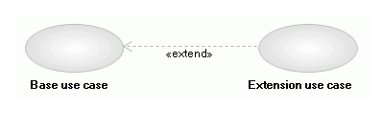
Use cases with extensions….
Process :
Original (base) use case runs in own description..
When it reaches the probe position, it checks condition of extension.
If true, it starts to follow extension use case’s description; when reaches to end, returns to original description where it left off.

Slide 18
Homogenization
Homogenization means that we try to get few stimuli as possible to maximize reusability and easy to work.
Example:
What_is_your_phone_number?
Where_do_you_live
Get_address
Get_address_and_phone_number
These could be homogenized to;
Get_address
Get_phone_number

Slide 19
Block Design
The Block Interface
Object Behavior
Internal block Structure
Implementation
Implementation of probes

Slide 20
The Block Interface
Requirements of the block design are obtained from the use cases and analysis model.
Actual implementation of blocks starts is started in the source code.
The protocol of each block is specified through the use case design and complete picture of the block interfaces can be extracted from interaction diagrams.
The interfaces can be extracted mechanically by means of CASE tool.

Slide 21
The Block Interface….
Requirements of block consists of attributes, attribute types, real-time requirements, memory space requirements, etc.
As we need to express block interface more explicitly and encapsulate its actual implementation, public and private object modules are defined.
Example of interface: Light switch.
-When we flip light switch, it goes ON, but we don’t care how, just that it does (described by interface) .

Slide 22
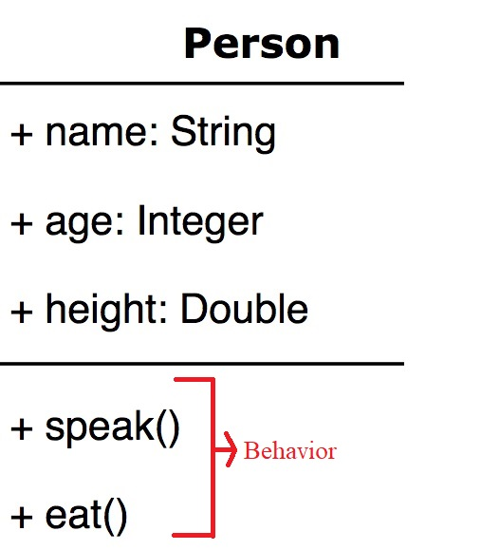
Object Behavior
Tasks/action/work/operation that an object performs.
Defined by methods which are the functions and subroutines defined within object class.
How an object acts and reacts in terms of state changes and message passing.
State transition graphs provide simple understanding of block without going through source code.
State transition graphs describe about stimuli.(which can be received and what will happen).

Slide 23
Internal block Structure
Outline of internal block structure is done after properties of block are identified.
Consists of object modules.
Object modules will be classes if implementation language is object-oriented and module units in other cases.
Blocks used in design module are abstraction mechanism for these object modules.
Blocks can be implemented as only one class, else one class for each object.
There will be more classes than objects in general.

Slide 24
Internal block Structure….
Classes are defined after structuring of block is done.
These classes can be homogenized as they are reusable and high-quality classes except in case of inheritance.
They can be splitted if more than one operations is done in single class.
It takes 5-10 times longer to design component class than an ordinary class.
It is important to use components in structuring the internals of a block.

Slide 25
Implementation
The components in the system are implemented and structured into implementation sub-systems.
Automatic code generation from design models helps accelerate this process.
Blocks can be implemented in the programming language.
Though there are automatic systems to translate from SDL into source code, human beings are needed to make final transition.
Adaptation to the language is made according to a specialization of the construction process.

Slide 26
Implementation….
Traceability from analysis model should be noticed since this property is invaluable while working on the maintenance of the system.
Specialization describes the terms used in design into terms and properties in the implementation language.
Coding rules are used to obtain a uniform source code by many projects and organizations.
These rules facilitate understanding and reading, and also achieves portability between different environments.
Specialization should not influence these rules.

Slide 27
Implementation of probes
Communication association is associated with a probe which specifies where the sequence should be inserted.
It means another behavior can be inserted in a use case description or its accompanying interaction diagram.
Original description must be independent of the new inserted behavior.
All of the control structure should be placed in the block containing the inserted use case.

Slide 28
Implementation of probes….
Since this cannot be accomplished with today’s programming languages, the probe must be implemented in the block where the sequence should be inserted.
One variable must be added to hold a reference to the inserted functionality and also the stimuli that should be sent to this object.
In traditional language where class concept is not used, the probe is implemented with a specific procedure.
When a change is needs to be made to the inserted sequence, only the probe procedure san be changed instead of procedure.

Slide 29
Working with construction
Existing products
Abstractions
Development is incremental
Further issues

Slide 30
Existing products
It is a common requirement to be used in the implementation environment.
Even if the limit for extending the existing product and making further development is fluctuating, there will be two different problems;
existing product is the same system, but in older version.
New system is built that only makes use of existing product since it already exists.
Components are used as powerful units when combined into objects.
Using an existing product is different ; where we must first make an analysis of product and adapt our design into it.

Slide 31
Existing products….
An assessment must be made whether to use an existing product (forced to adapt our design into it) or not (decide to develop functionality own).
If existing product is used, it requires fewer resources.
If existing product is not used, we have a homogeneous system that is easier to maintain.
In long run , it is very expensive to change a system architecture fundamentally; and hence should be avoided.
It is important to decide whether we should use old or develop something new to consider the testing costs.

Slide 32
Abstractions
We must be able to handle the system complexity when developing systems at large scale.
It is the important issue for abstractions on different levels.
Blocks are used to encapsulate and thus abstract actual implementation details.
This will help to group several classes in the actual system to one block in the design model.
We must find some way of grouping the blocks into larger units.
Larger the number of blocks, difficult to handle complexity which is hard to manage.

Slide 33
Development is incremental
The process of construction seems straightforward and an easy road to follow but, this may not be true.
Development is an incremental process and many iterations must be done before all stimuli are defined and interfaces can be frozen.
When implementation has started, changes to the definitions of stimuli will still occur.
What is important is to find a way to handle all these through the following:

Slide 34
Development is incremental….
Start the construction early, preferably with parallel to analysis model.
The time of transition must be decided early and decision should be based on the result from identification of the implementation environment.
Try to take one shot through all models initially, particularly if not experienced in OOSE.
Thus iterations may exist on several different levels of granularity.

Slide 35
Further issues
Following simplifications can be mentioned from construction and analysis:
The above described points only reflect the method; process are left out.
In real development, much more interaction is done between different parts.
Other activities such as configuration management and reviews also take place which are extremely important in a real development.
The tests of the blocks and object modules are done by the designer.
The testing of the use cases and whole system is done by special testers, often in a special test department.

Slide 36
Thank You

